Slide 1
Evolution and the Human Soul
Darwin Meets Thomas Aquinas
Cory Hayes, Ph.D.
St. Joseph Seminary College
St. Benedict, La

Slide 2
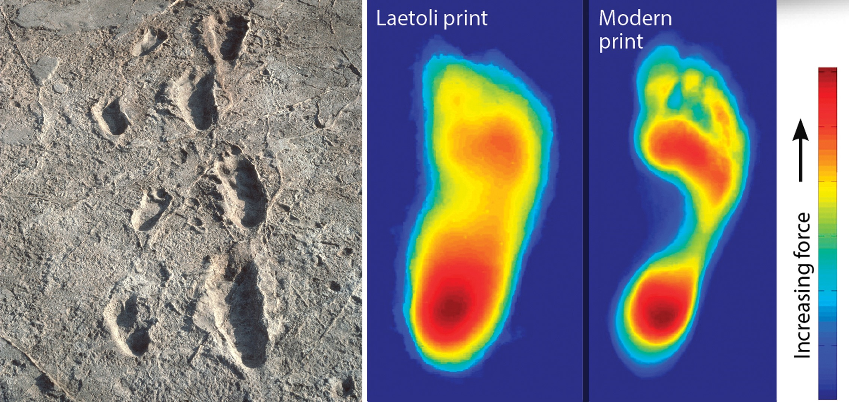
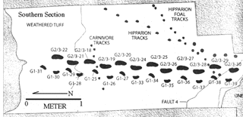
The prints were made by Australopithicines 3.6 MYA

Slide 3
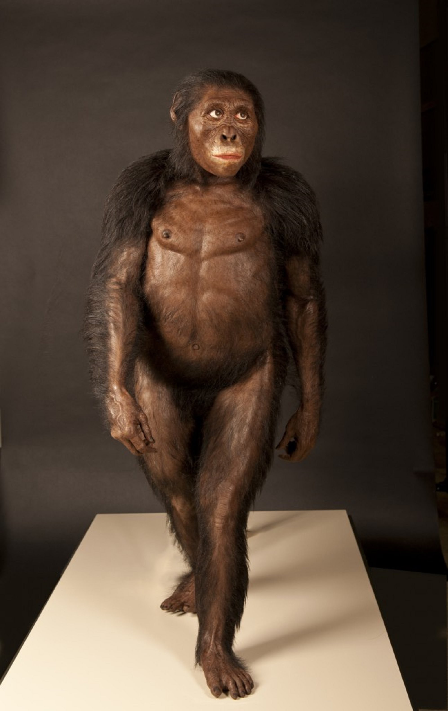
Australopithecus afarensis (“Southern Ape from Afar”) Best Fossil: Lucy (reconstructed below)
3.85-2.9 MYA (4x’s longer than Homo Sapiens)
Eastern Africa (Ethiopia, Kenya, Tanzania)
Like Apes: flat nose, projecting lower jaw, small braincase (500 cubic centimeters, 1/3 of modern human brain), strong sexual dimorphism, curved fingers for climbing trees
(Like Us): small canine teeth (good for chewing), bipedalism (Laetoli footprints)
Key to Species Success: Combining climbing and walking, they could adapt to a great variety of climactic conditions
EVO FACTOR #1: CLIMATE CHANGE

Slide 4
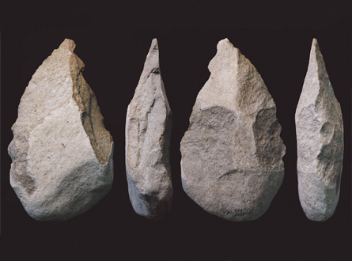
Early Hominid Handaxes

Slide 5
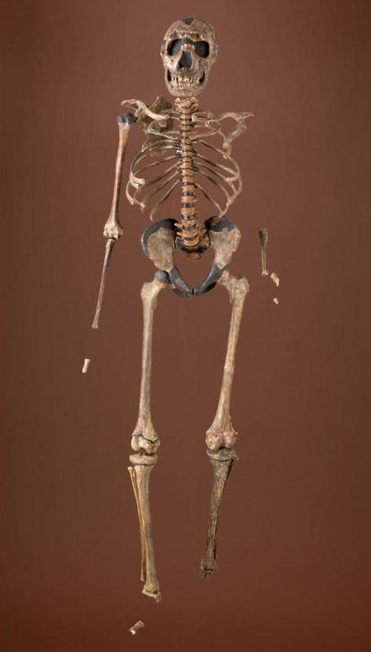
Homo Ergaster (Working Man) Best Fossil: Turkana Boy (pictured below) Total fossils: 300 individuals
1.9-1.5 MYA
Eastern Africa (Ethiopia, Kenya, Tanzania)
Like Apes: Minimal, with two major exceptions: 1) rapid growth (Turkana Boy was 5’3” tall when he died at the age of 8; 6’0” if he had grown to maturity); 2) small braincase (600-850) cubic centimeters
Like Us: facial proportions, barrel ribcage, short arms relative to legs, longer leg bones, small hands/better manual dexterity, serious meat and fish-eater (reduced gut)
Key to Species Success: 1st stone tools, highly mobile, fire-use???, use of ochre (body painting)
EVO FACTOR #2: REGULATORY DNA→RADICAL CHANGE
EVO FACTOR #3: DIET

Slide 6
Prosociality
Any behavior in which a member of a group acts in such a way to alleviate another group member’s need or improve another’s welfare at cost to its own self.

Slide 7
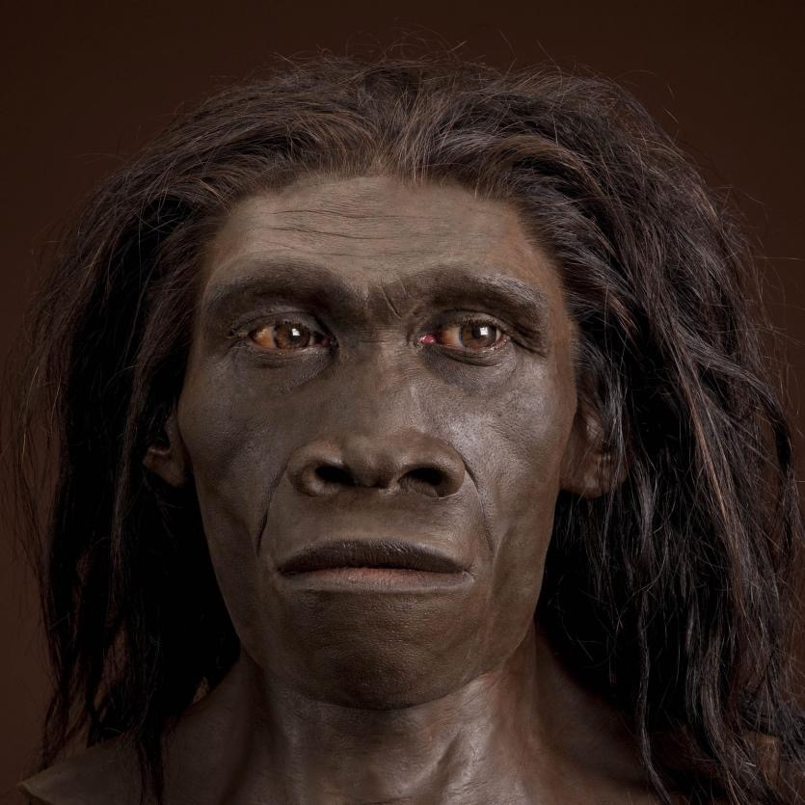
Homo Erectus (Upright Man) Best Fossil: Disputed due to Classification 1st Fossil Discovery: “Java Man” in 1891 (Eugene Dubois)
1.89 MYA-70 KYA
Northern, Eastern, and Southern Africa; Western Asia (Dmanisi, Republic of Georgia); East Asia (China and Indonesia)
Like Apes: No longer a helpful standard
Unlike Apes, Somewhat like Us: Bigger braincase into our own range (750-1300 cubic centimeters, Sapiens = 1000-2000 cc)
Maybe Ergaster = Erectus?
Like Us: (see Ergaster) facial proportions, barrel ribcage, short arms relative to legs, longer leg bones, small hands/better manual dexterity, serious meat and fish-eater (reduced gut)
Key to Species Success: 1st handaxes (Africa only), world-travelers, first hearth (control of fire)
EVO FACTOR #4: MIGRATION

Slide 8
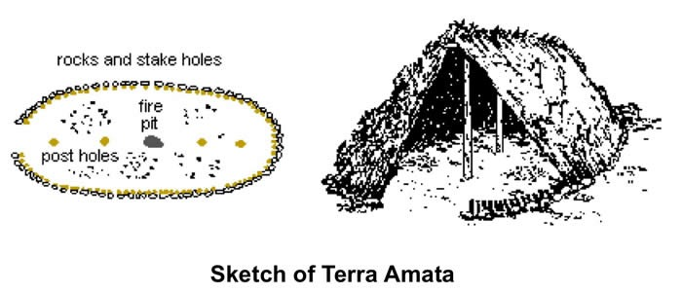
380 KYA
The shelters were located on an ancient beach near Nice, France.
Oval rings of stone marked the outer dimensions and served to anchor saplings.
Charred wood and bones point to control and use of fire.
Other sites of the same type found in France, England and Hungary.
Pieces of red and yellow pigment were also found.

Slide 9
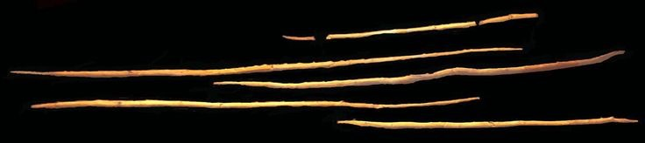
300 KYA
Found in a peat bog in northern Germany, these spears were found near the remains of 10 wild horses and numerous other mammals that had been butchered.
The use of projectile technology by heidelbergensis is not known in any hominid species before it.
The spears are 6’ long and shaped like Olympic javelins, with weight concentrated toward the front.

Slide 10
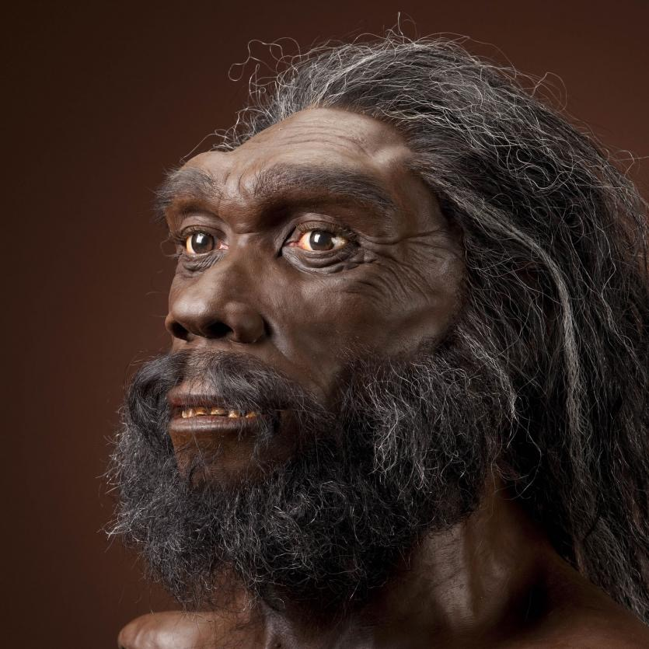
Homo Heidelbergensis (Heidelberg Man) Best Fossil: Disputed due to Classification 1st Fossil Discovery: “Java Man” in 1891 (Eugene Dubois)
700-200 KYA
Europe; possibly Asia (China); Africa (eastern and southern)
Like Homo Erectus: Prominent brow ridge,
Like Homo Neanderthal: Powerful, muscular form, wide pelvis
Like Us and Neanderthal: large brain size (1100-1400 cc), less pronounced sexual dimorphism
Species “Firsts”: First to live in colder climates (short, wide bodies were likely an adaptation to conserving heat). First composite tools. First definite use of wooden throwing spears for large animal hunting. First to build shelters, creating simple dwellings out of wood and rock.

Slide 11
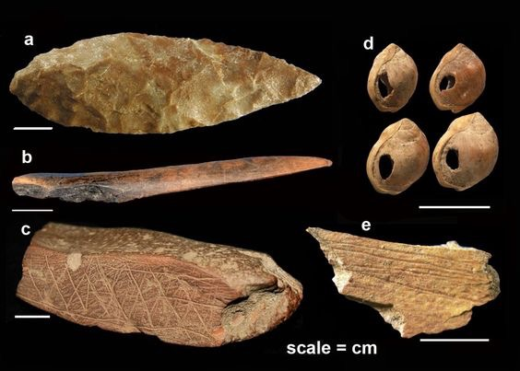
BLOMBOS ARTIFACTS (SILCRETE, TOP LEFT)

Slide 12
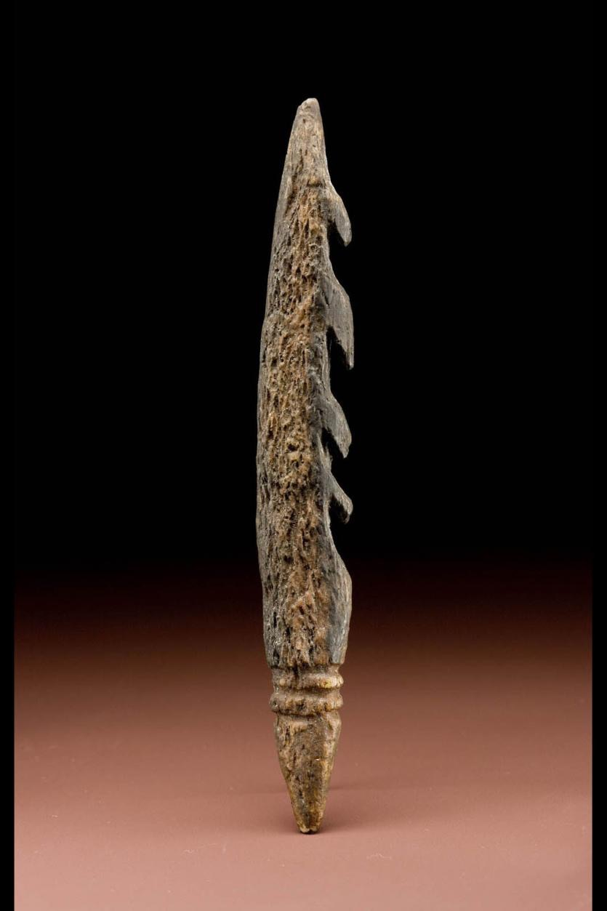
KATANDA BONE HARPOON

Slide 13
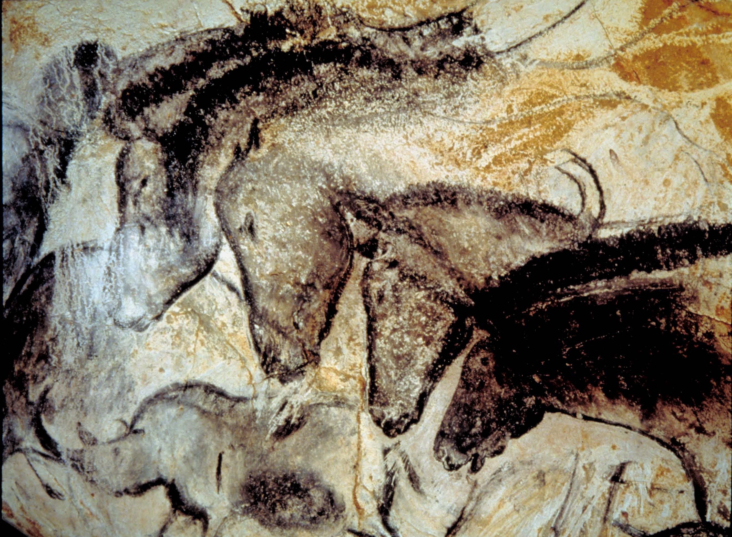
KATANDA BONE HARPOON

Slide 14
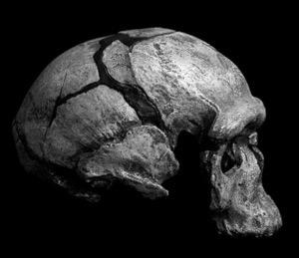
JEBEL IRHOUD

Slide 15
Outline:
1: What makes a human being?
2: What is soul?
3: What is rationality?
4: Ensoulment and the first humans.
5: Adam, Eve and Original Sin

Slide 16
A Difference in Method:
‣ The biological classification (taxonomy) of the genus homo (human) is based on morphological and genetic features of animals, i.e., bipedalism, skull and brain size, skeletal features, etc.
‣ Modern scientific classification is concerned with the extrinsic. It isn’t concerned with claims about the nature or being of anything.
‣ When used in isolation this perspective seems to suggest that members of the genus homo differ from one another only in degree.

Slide 17
A Difference in Method:
‣ The way of philosophical psychology and anthropology attempts to classify according to insights into the nature or being of things as they manifest themselves in activity.
‣ Philosophy is concerned with the intrinsic.
‣ Philosophy is concerned with physical and morphological characteristics only insofar as they manifest the nature of the thing involved.
‣ From this perspective, the human being is a rational animal in possession of a rational soul and therefore differs radically in kind from all other known living things.

Slide 18
What is Soul?
(According to Scholastic Philosophy)
‣ Soul (Gk: psyche) is the form of a living body. It is that principle which accounts for the organized structure which makes certain bodies living, organic unities of being and action.
‣ A soul is not a thing, but the chief organizing aspect of a living thing.
“The soul is not the entire man and I am not my soul” --St. Thomas Aquinas (In 1Cor. 15.2, n.924)

Slide 19
Systems biology is based on the understanding that the whole is greater than the sum of its parts...It is a holistic approach to deciphering the complexity of biological systems that starts from the understanding that the networks that form the whole of living organisms are more than the sum of their parts.
-Institute for Systems Biology, Seattle, WA

Slide 20
Animal Powers
(Summa Theologiae, Ia, q.78, a.4)
‣ Common Sense: the ability to distinguish between and compare different kinds of sensation
‣ Memory and Imagination: the ability to retain and recall sense experiences of particular things in such a way as to conjure up mental pictures of them and to be able to learn from past experiences.
‣ Estimative Power: the ability to direct mental activities towards external objects in such a way so as to perceive those objects as beneficial, harmful, etc.

Slide 21
Rationality
‣ The power to abstract universal concepts and meanings from sense experiences of particular things.
‣ The ability to gain insight into the natures of things and the universal and necessary laws of logic and mathematics
‣ Rationality both transcends and transforms our animal capacities.

Slide 22
Catholic Dogma Concerning the Human Soul:
‣ The human being is a unity of material body and spiritual soul which is the form of the body. (Lateran IV, Vienne, Vatican I)
‣ Each human soul is individual and immortal. (Lateran V)
‣ Every human soul is created immediately by God. (Lateran V)
‣ Ensoulment: the body and soul of each human being comes into being simultaneously—No Soul Cannon!

Slide 23
Catholic Dogma Concerning Human Origins
‣ The first human being (Adam) was created by God through and act of special creation—this dogma does not exclude created causes producing the first man’s body; only his soul. (Lateran IV, Vatican I)
‣ Adam and Eve had sanctifying grace and the preternatural gifts (at the very least immortality). Their vocation was to pass on these gifts to their posterity. (Trent)
‣ Adam and Eve lost these gifts by a historical sin, the consequences of which are passed on by generation to the rest of humanity, i.e., alienation from God, mortality, etc. (Trent)
‣ Original Sin consist primarily in the deprivation of sanctifying grace (Trent)

Slide 24
One Couple: Do we all come from Adam?
When, however, there is question of another conjectural opinion, namely polygenism, the children of the Church by no means enjoy such liberty. For the faithful cannot embrace that opinion which maintains that either after Adam there existed on this earth true men who did not take their origin through natural generation from him as from the first parent of all, or that Adam represents a certain number of first parents. Now it is in no way apparent how such an opinion can be reconciled with that which the sources of revealed truth and the documents of the Teaching Authority of the Church propose with regard to original sin, which proceeds from a sin actually committed by an individual Adam and which, through generation, is passed on to all and is in everyone as his own.
--Pius XII, Humani generis, 70 (1951)

Slide 25
One Couple: Do we all come from Adam?
While the story of human origins is complex and subject to revision, physical anthropology and molecular biology combine to make a convincing case for the origin of the human species in Africa about 150,000 years ago in a humanoid population of common genetic lineage...Catholic theology affirms that that the emergence of the first members of the human species (whether as individuals or in populations) represents an event that is not susceptible of a purely natural explanation and which can appropriately be attributed to divine intervention.
--International Theological Commision, Communion and Stewardship, 63 & 70 (2004)

